Slide 1
UNIT 7
Microsoft Windows Security Tools

Slide 2
Learning Objectives
Understand where basic Windows operating system security tools are located
  Control Panel and Windows Settings
  Administrative Tools
  Security and Maintenance
  Windows Defender Security Center
  Windows Defender Firewall
  Windows Update
Learn how to manage Windows accounts and how accounts can affect security

Slide 3
UNIT 7 – SECTION 1
Basic Security Policies and Tools

Slide 4
Note on Windows Security Tools
Windows has several versions (Professional, Home, etc.)
Each version has sets of security tools with different looks, capabilities, and ways to access them.
This training unit has several options for accessing almost all the security tools to perform specific tasks.
In any case, the search capability in the Windows versions will assist users and administrators in finding the appropriate tool for a task.

Slide 5
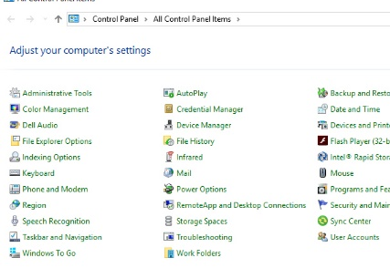
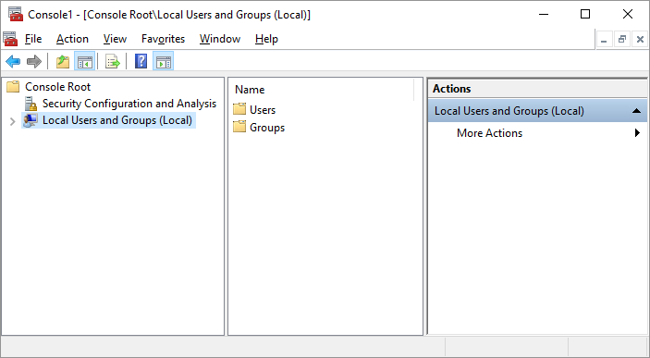
Security and Administration Tools
Windows has several components with groups of security and administration tools.
You must be an administrator to use most
of the tools
Some of the components are:
  Windows Settings
  Control Panel
  Microsoft Management Console
  (MMC) (for advanced settings)
Control Panel
MMC

Slide 6
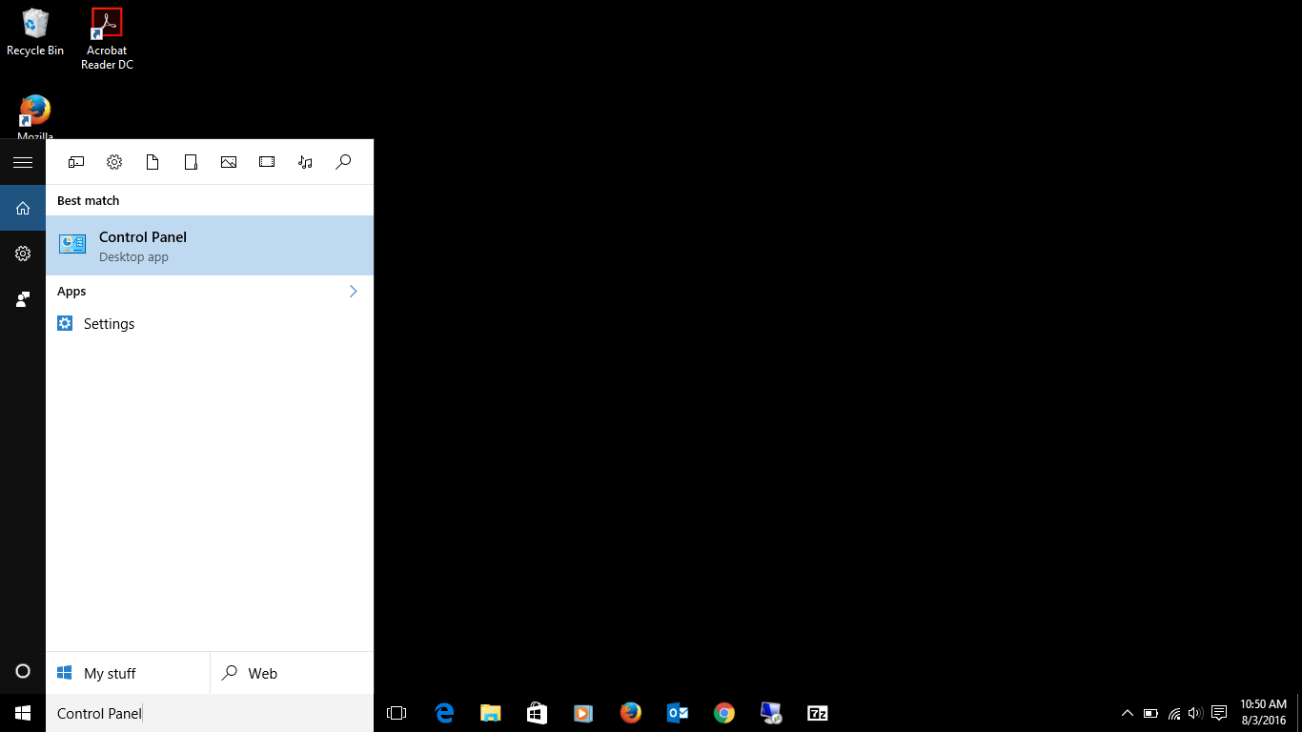
Windows Search Bar
Windows 10 has a search bar that can bring up anything you need on your system
You can use the search bar to find any of these upcoming areas if you don’t know the direct path

Slide 7
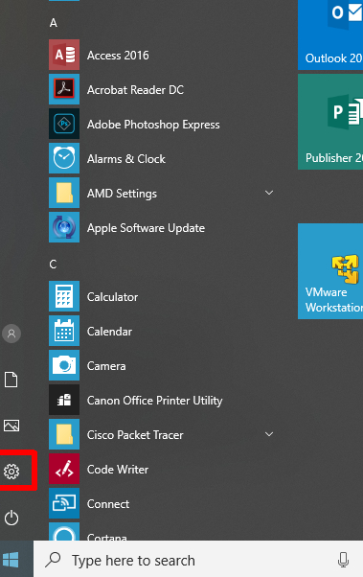
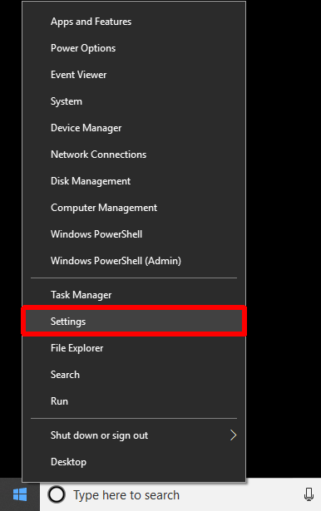
Windows Settings
Where many of the basic system changes and configurations can be set within a Windows 10 operating system is a little different depending on the version of the operating system.
Click Start → Settings icon
OR Right Click Start → Settings

Slide 8
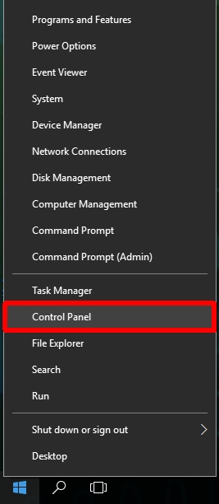
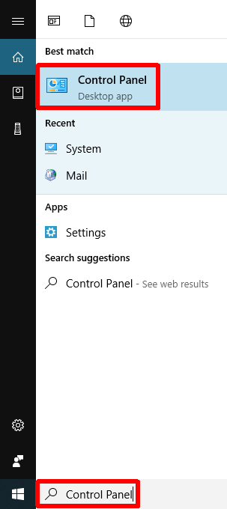
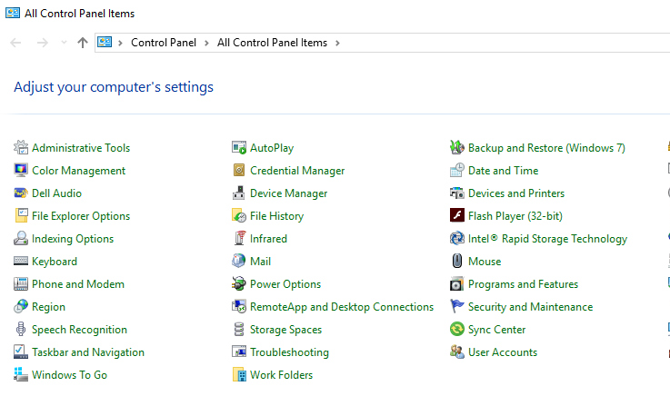
Control Panel and Search
Control Panel resides in Windows 10 and is more robust than Settings. If you do not see it on your Start menu, you may search for it. Search may be used to find most configuration and security tools within Windows.
Right Click Start → Control Panel
OR Click “Type here to search” → Type Control Panel → Click Control Panel
Control Panel

Slide 9
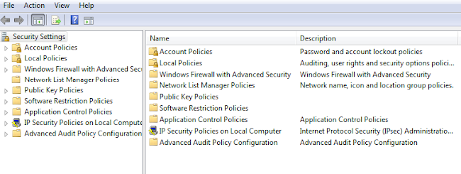
Basic Local Security Policies
Controls security settings on user computers within a network
Control Panel→ Administrative Tools → Local Security Policy
OR Search → Administrative Tools → Local Security Policy

Slide 10
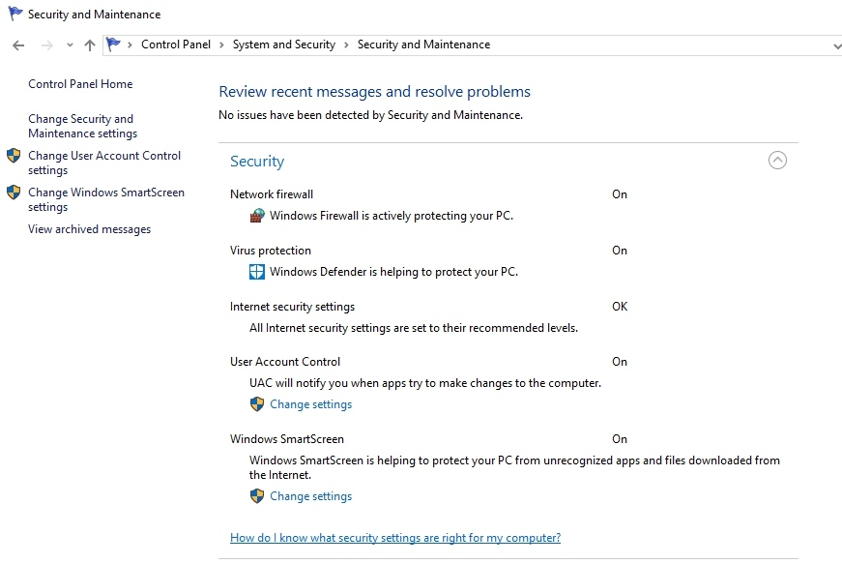
Windows Defender Security Center
Window Defender is an important defensive tool in Windows. To open Windows Defender:
Click Start → Settings→ Windows Settings → Update and Security → Windows Security
OR Click Start → Control Panel→ System and Security → Security and Maintenance→ Security
Notifies you if Windows identifies problems
with or updates for:
  Windows Updates
  Internet security settings
  Network firewall
  Spyware and related protection
  User Account Control
  Virus protections
  Windows Backups

Slide 11



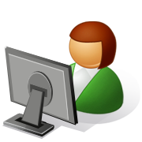
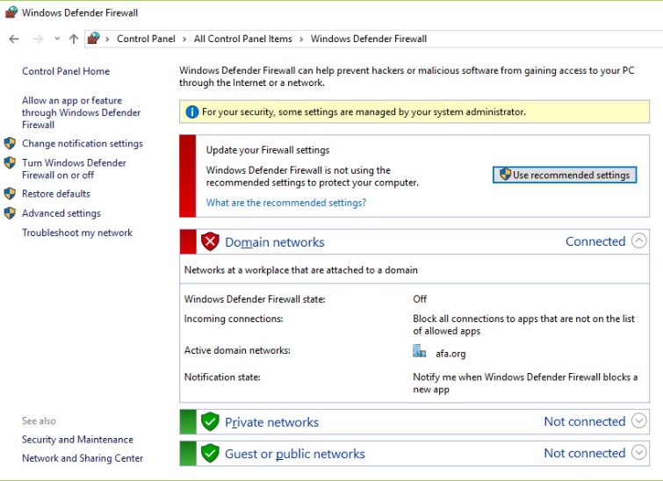
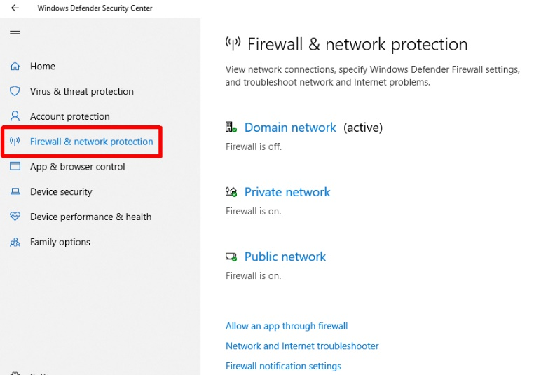
Firewalls
Reject or allow data packets through to users based on custom settings
Essential to security and should always be turned ‘on’ and use “Recommended Settings” at a minimum
Click Start → Windows Settings → Update and Security → Windows Security → Firewall & network protection
OR Right Click Start → Control Panel→ Windows (Defender) Firewall
OR Search→ Firewall
0
Windows Defender Firewall
Windows Defender Security Center
Note: Both firewall settings are for the same firewalls.

Slide 12
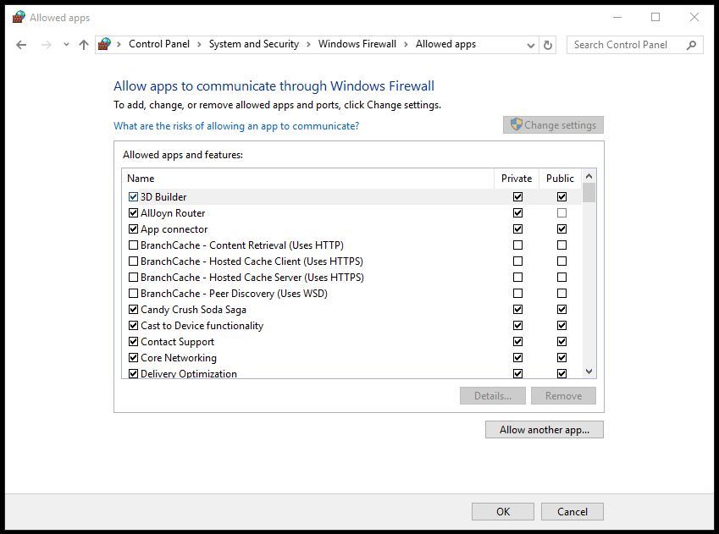
Enabling Windows Firewall Exceptions
  For each network type, you can customize whether you want the programs allowed through
It’s much safer to allow only certain programs through your firewall than to open an entire port to traffic
  Ports are numbers that identify one side of a connection between two computers

Slide 13
Common Firewall Exceptions
Core Networking
  Regular Microsoft Windows services that retrieve data from the Internet
  If you don’t enable this exception across all three types of networks, some Microsoft services and programs will not run properly
File and Printer Sharing
  Allows you to share the contents of selected folders and locally attached printers with other computers
Remote Assistance
  Allows a user to temporarily remotely control another Windows computer over a network or the Internet to resolve issues
Remote Desktop
  Allows users to access their user accounts and files remotely
UPnP Framework (Universal Plug-and-Play)
  Allows devices to connect to and automatically establish working configurations with other devices on the same network

Slide 14
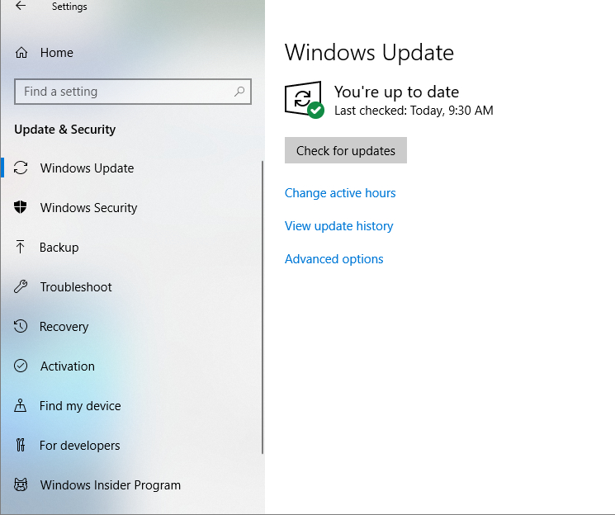
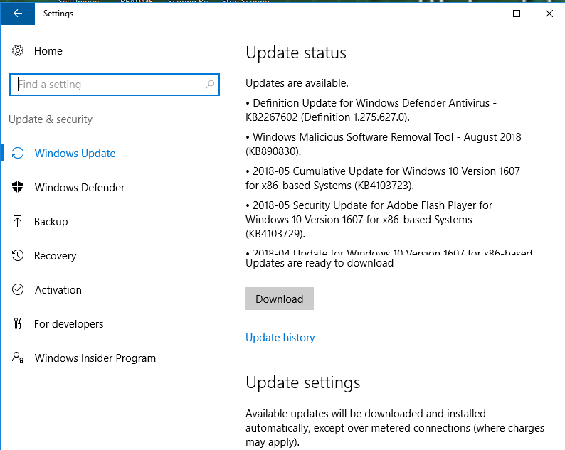
Windows Update
Prevent or fix known problems in Windows software or improve user experience
Should be installed regularly
  To avoid missing updates, allow Windows Update to check for them daily and install them automatically
Windows Settings 🡢 Updates and Security🡢 Windows Security🡢 Windows Update
OR Search 🡢 Windows Update
Windows Settings
Search Windows
Update

Slide 15
UNIT 7 – SECTION 2
Account Management

Slide 16
Account Groups
System Accounts
Admin Accounts
The most advanced accounts
Typically held by IT Staff only
Admins can change security settings for other users, install resources, and access and modify all files on a network
User Accounts
Allow people to share a computer and network resources, but still have their own files and settings
Have fewer rights and permissions than Admin accounts
Domain Accounts
Allow users to access their accounts from any computer in the network
Username and password reside on a domain controller (a type of server that manages all the accounts on a network)
Local Accounts
Allow access to a specific computer only
Username and password are stored on the computer itself

Slide 17
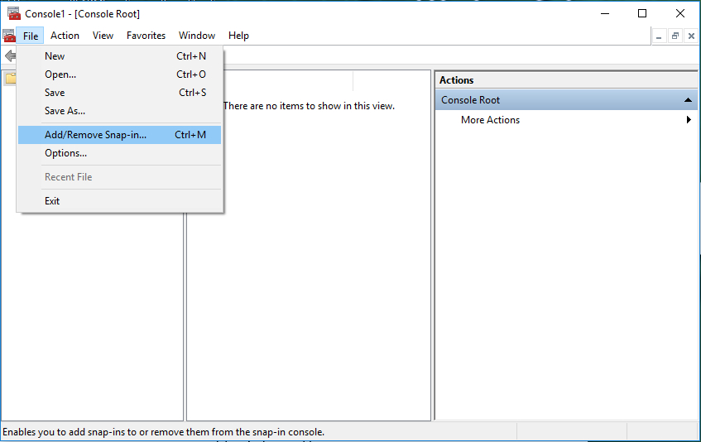
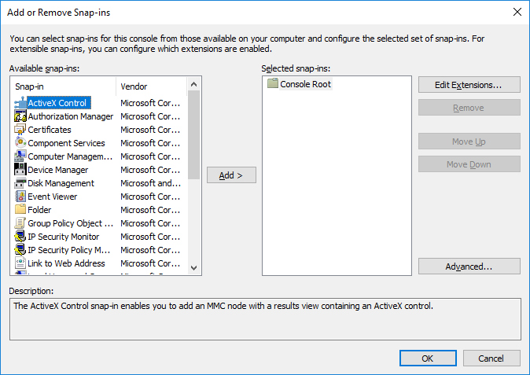
Microsoft Management Console (MMC)
The Windows component that allows administrators to make group and detailed security settings is the Microsoft Management Console or MMC. MMC can be found using Search. It cannot be accessed through Windows Settings or Control Panel.
MMC allows settings to be made to user and group permissions.
Snap-ins are the tools the MMC accesses to making settings. Snap-ins must be opened in MMC. They do not automatically appear when MMC is executed.
To access MMC: Search 🡢 “mmc”🡢 Click “yes" to allow changes to computer
To access Snap-ins in MMC: Click File 🡢 Add/Remove Snap-ins
*The following slides will show you how to control user access through Control Panel and through the Local Users and Groups Console. Other methods exist and you can choose which to use based on personal preference.

Slide 18
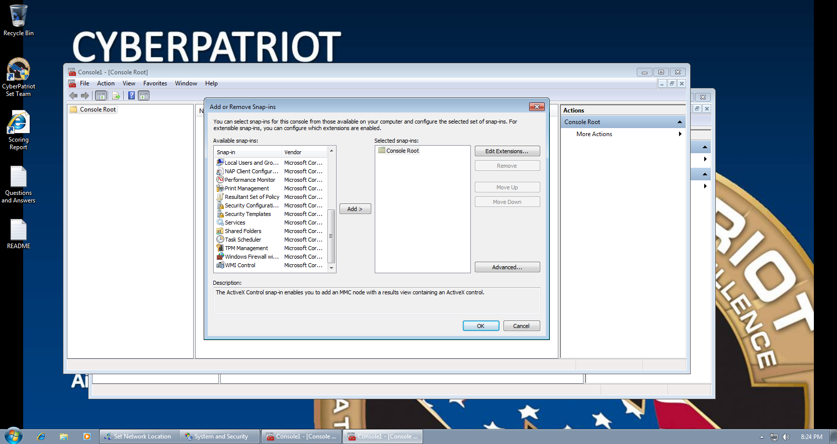
Local Users and Groups Console
Windows categorizes accounts as user or
administrator accounts so that it can
automatically apply the relevant permissions
and rights
Define a user’s level of access by categorizing
his or her account as a user or administrator
To set up the Local Users and Groups Console:
Start Menu 🡢 Search “mmc”🡢 Click “yes” to allow changes to computer 🡢 Click File 🡢 Add/Remove Snap-ins 🡢 Select “Local Users and Groups 🡢 Select “Add” 🡢 Select “Finish” 🡢 Click “OK”
*The following slides will show you how to control user access through Control Panel and through the Local Users and Groups Console. Other methods exist and you can choose which to use based on personal preference.

Slide 19
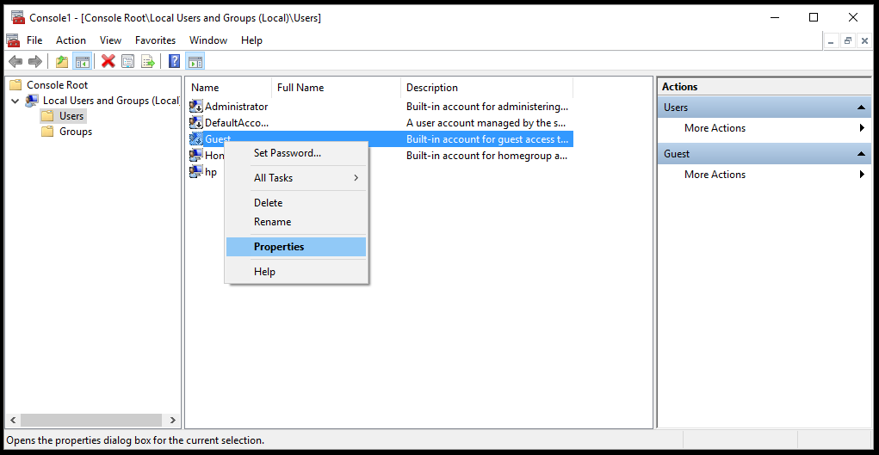
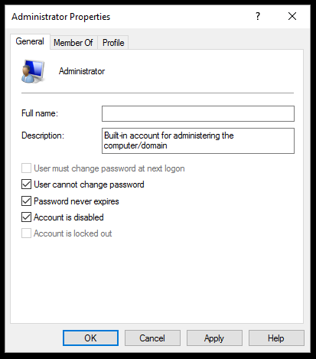
Best Practice: Disable the Built-in Guest Account
Disable this account so people cannot anonymously access a computer
While someone on a Guest account will not have direct access to other users’ information, he or she can still significantly disrupt the resources of the local computer
1.
2.

Slide 20
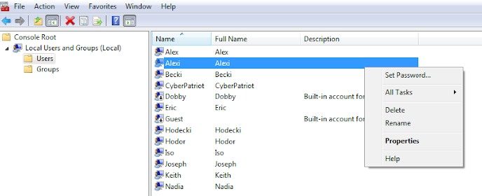
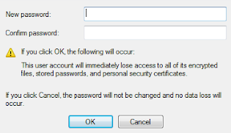
Best Practice: Set Passwords for all Accounts
Make sure all accounts are password protected*
Users 🡢 Right click name 🡢 Set password
Console option:

